Slide 1


WIPS
Presented By
Darshan K S
Research Assistant, MIRC
DSI

Slide 2
Outline
4 channel Phased array for 1.5T
Wrist coil for 405kHz
RF sub system integration
16 channel head coil arrangement

Slide 3
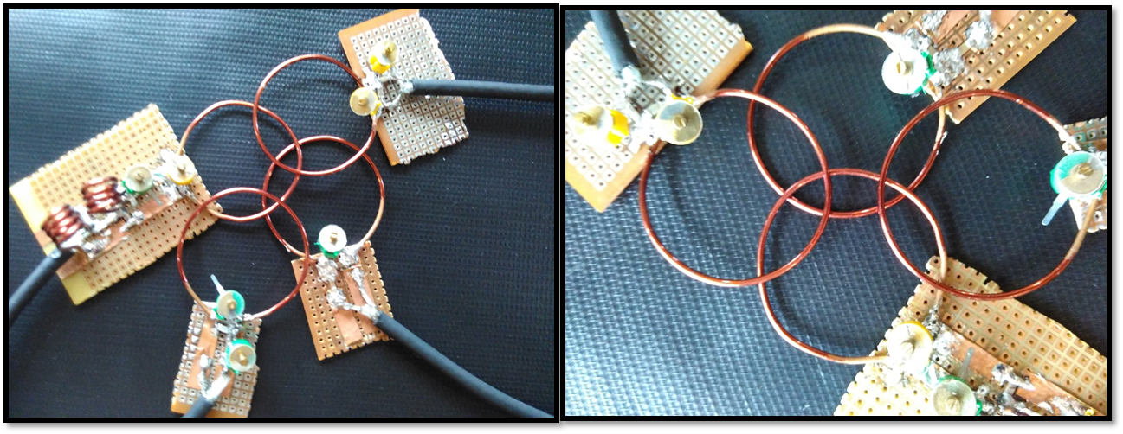
Phased array coils
Surface coil with
critical overlap
Tuning and matching
circuit
Coil specification
1. Diameter = 3.5cm
2. Wire gauge = 22
Balun
circuit
Figure: 4 channel surface coil arrangement with coil overlap at 63.8MHz

Slide 4
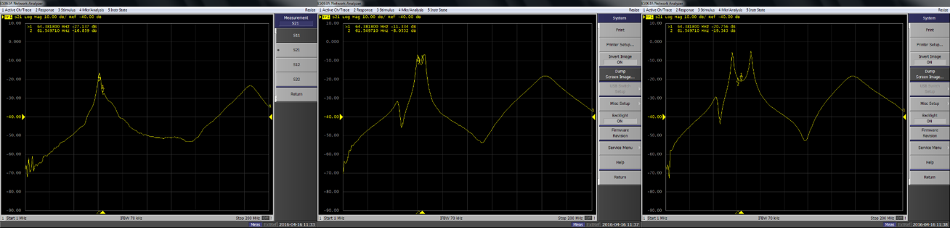
Geometrical Decoupling
Fig: Single loop coil resonating at
63.5MHz
Fig: Two ‘peak’ are separated by small
distance, due to proper geometrical overlap
Fig: Two separated ‘peak’ are observed
in a single coil when there is either too
much overlapped or too little overlapped

Slide 5
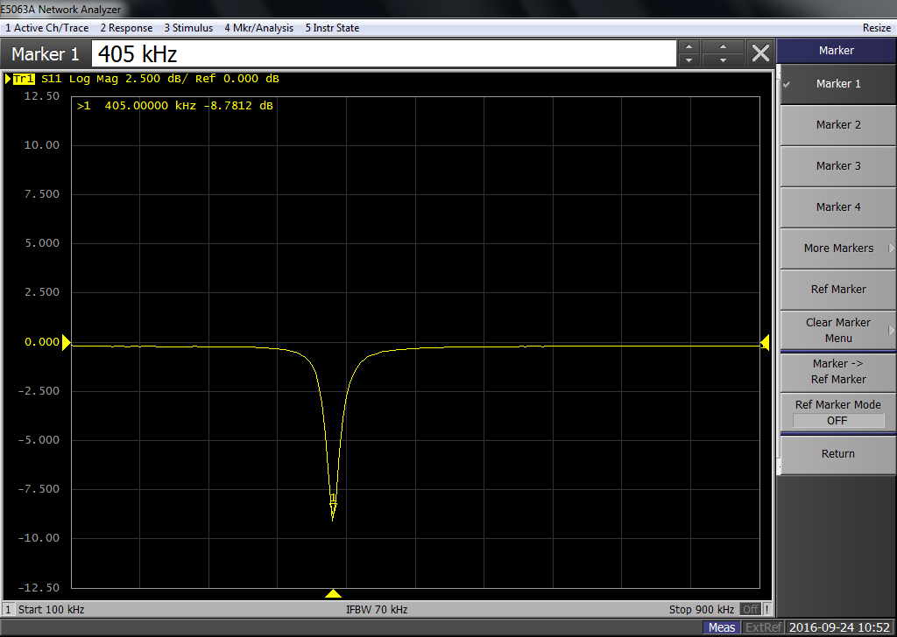
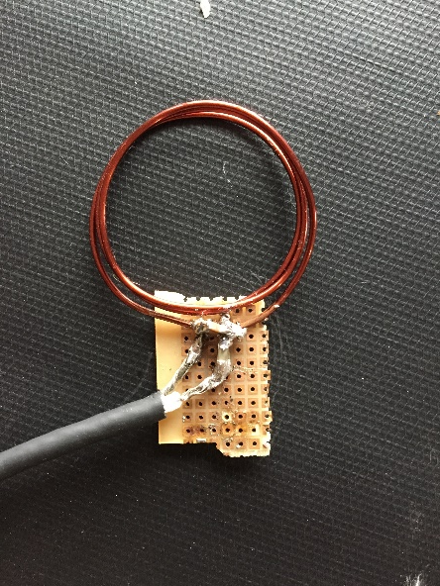
Multi turn Single channel wrist coil (405kHz)
Coil specification
Number of turns = 3
Diameter = 35mm
Copper gauge = 18
Inductance = 0.9uH
C _{T} = 320nF
C _{M} = 23.2nF
Coil tuned to 405kHz
Gain -9dB

Slide 6
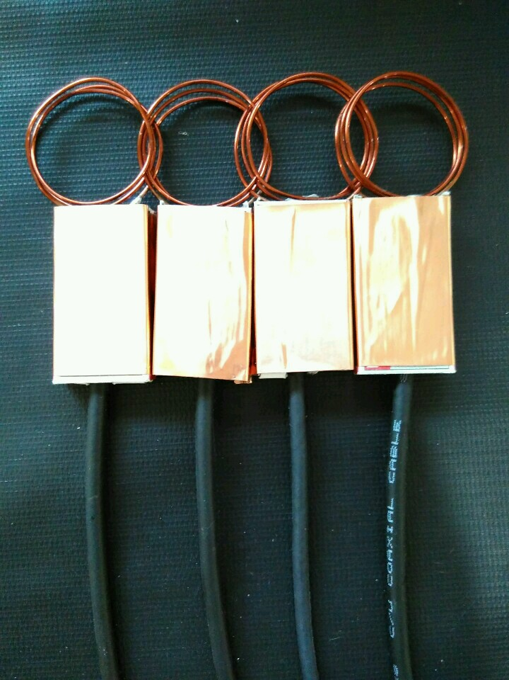
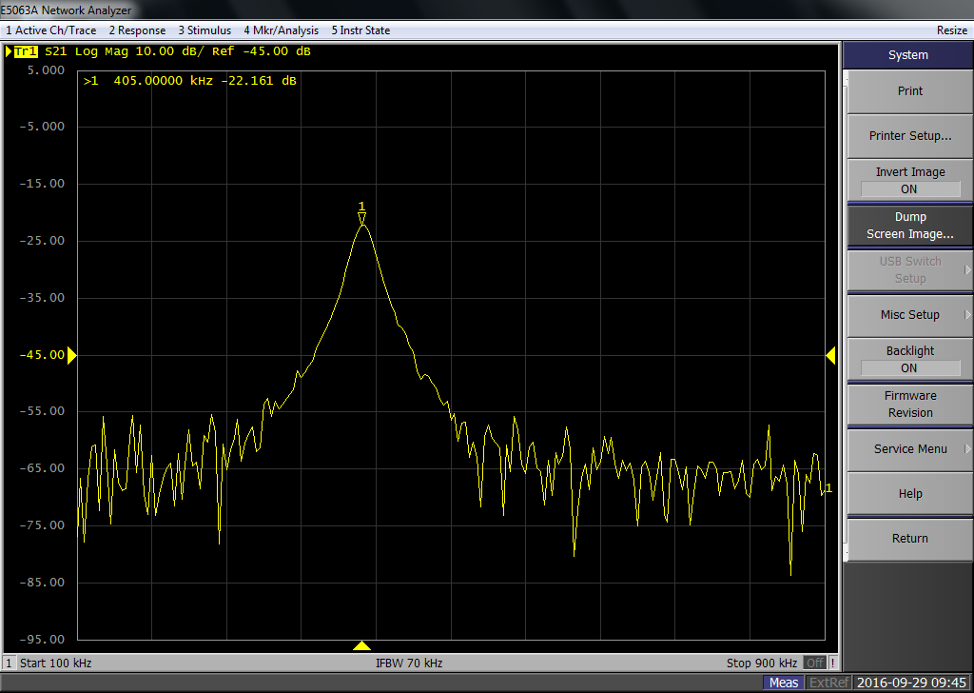
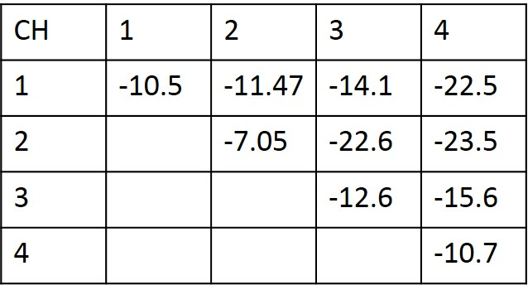
Coil placements and mutual coupling
Coil overlap region
1. Overlap distance between
1st and 2nd is 0.6cm
2. Overlap distance between
2st and 3nd is 1.1cm
3. Overlap distance between
3st and 4nd is 0.8cm
Fig: Mutual coupling at different overlapping distance
Fig: Measured S parameter

Slide 7
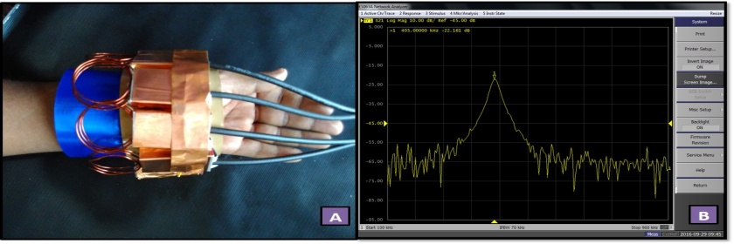
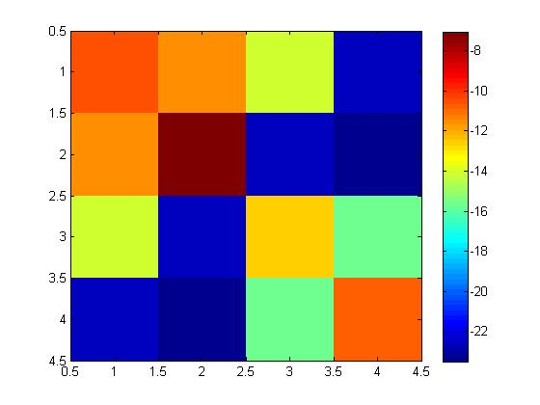
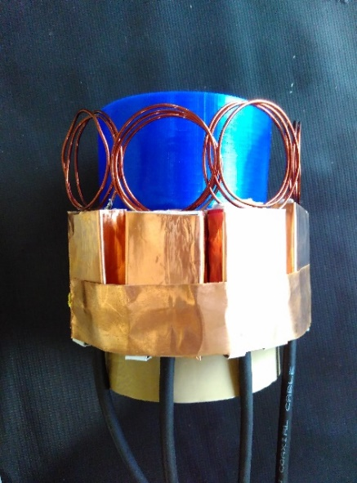
Frequency response of the coil
Fig: Assembled four
channel wrist coil
Figure A: 4 - channel receive array loaded with human hand
Figure B: Measured S₂₁ of adjacent coils of receive array
Fig : S-parameter Matrix in dB

Slide 8
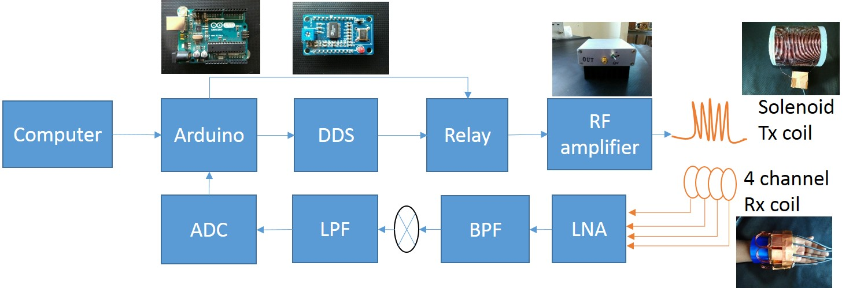
RF sub system Integration

Slide 9
Preliminary Design for 16 channel head coil arrangement
Anterior to posterior (25cm)
Left to right ( 20cm)
Diameter = 3inch
Number of coils = 16
Overlap between two coil = 0.5 inch
Helmet – coil design
8 channel – 118mm (diameter)
32 channel – 92mm
48 channel – 72mm
64 channel – 64mm
128 channel – 44mm

Slide 10
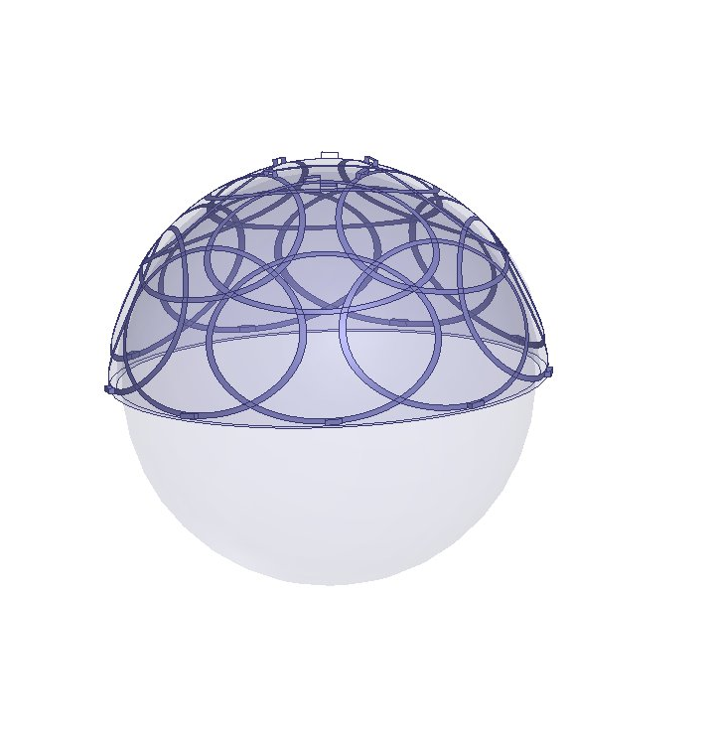
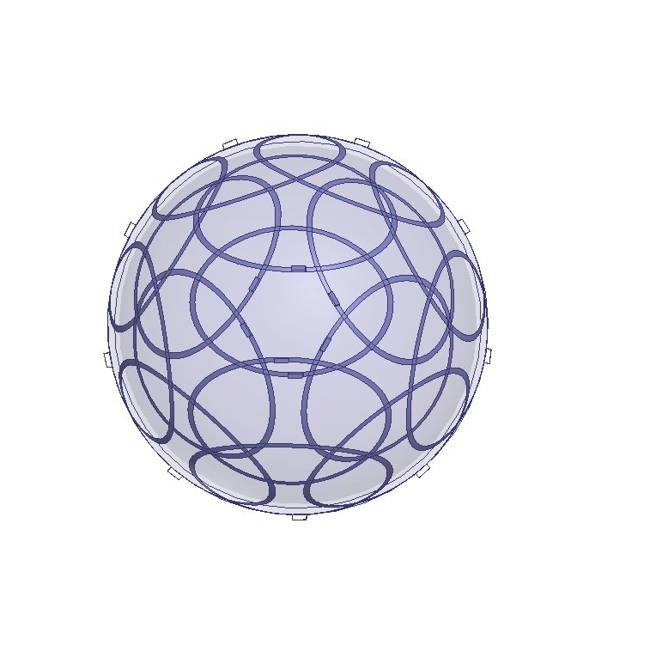
HFSS Simulation: 16 channel phased array head coil
Version 1
Return loss of Individual loop
Inter Element coupling
Figure: Side view and top view of 16 channel coil arrangement
Specification:
16 element phased array head coil
Coil Radius = 35mm
Inductance= 4nH
Capacitance = 19pF
Helmet Design:
Diameter = 170mm

Slide 11
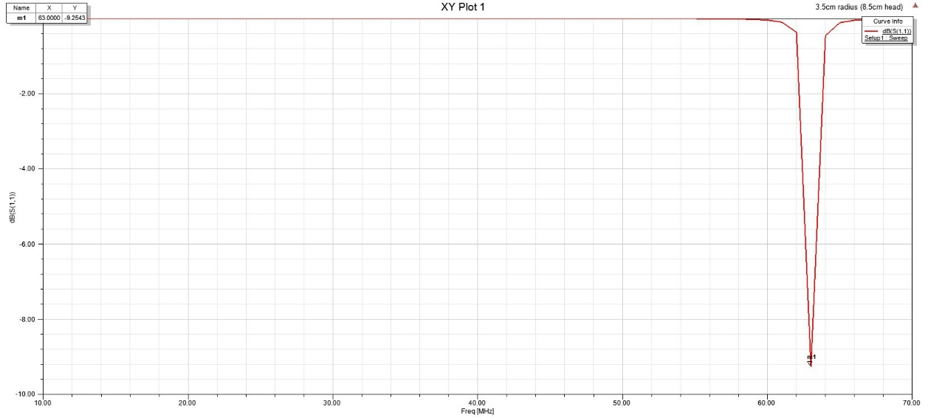
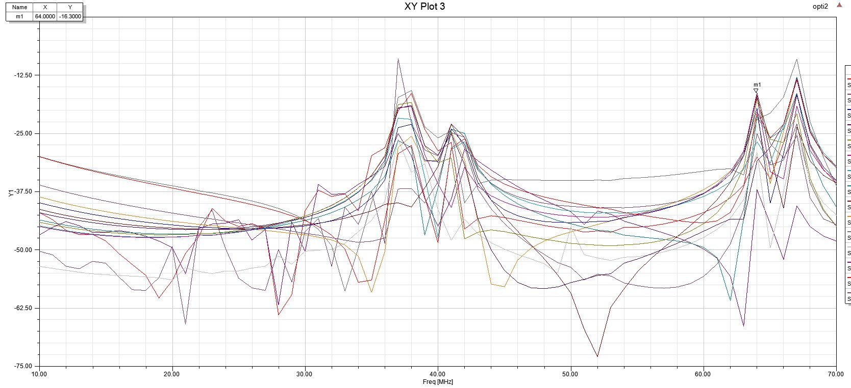
Simulation result: Single coil
Figure: Single coil element resonating
at 64MHz with -9.2dB (S ₁₁ measurement)
Figure: Mutual coupling between the coils
(S ₂₁ measurement)

